Slide 1




Embedded Systems Workshop
Session
5

Slide 2




Hello!
Instructor: Mohamed Magdy
Cairo University, Electrical Engineering ( EPE ) Department.
Contact me: mohamed.naem04@eng-st.cu.edu.eg
LinkedIn: https://shorturl.at/hgsIP
@ 2026 Mohamed Magdy

Slide 3

@ 2026 Mohamed Magdy

Slide 4

AGENDA :
Keypad scanning
LCD interfacing
@ 2026 Mohamed Magdy

Slide 5

Keypad
@ 2026 Mohamed Magdy
@ 2026 Mohamed Magdy

Slide 6


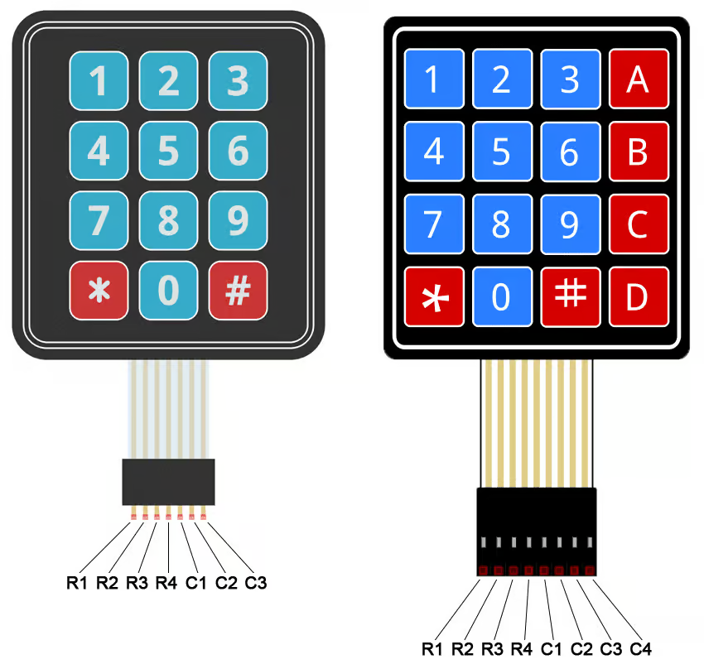
What is keypad ?
@ 2026 Mohamed Magdy

Slide 7


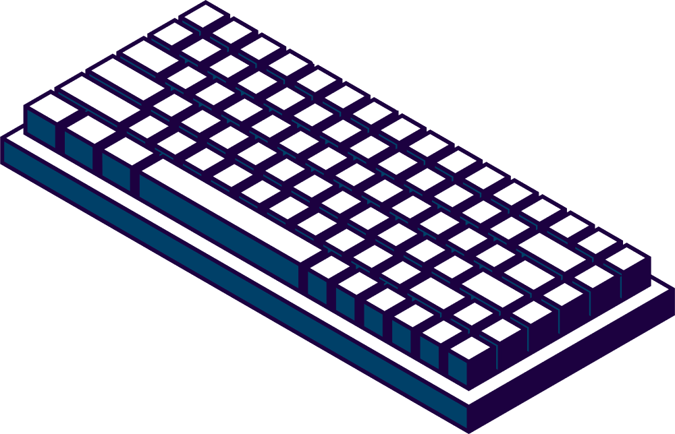
What is keypad ?
Keypad: is a set of a mechanical switches that are arranged in a matrix to minimize the number of the used pins and it is used as an input device to read the key pressed by the user and then process it by the MCU
Many applications requires large number of keys connected to computing systesms
Examples : PC Keyboard ,Cell Phone Keypad and Calculators
@ 2026 Mohamed Magdy

Slide 8
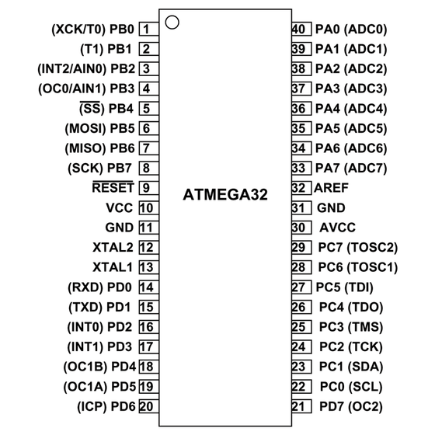
What is the Challenge ?!
When we want to interface one key to the microcontroller then it needs one GPIO pin But when we want to interface many keys like 9 , 12 ,16 or even more then it may acquire all the GPIO pins of the microcontroller
@ 2026 Mohamed Magdy

Slide 9
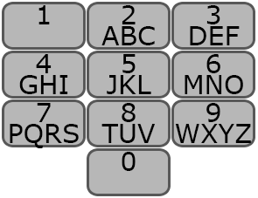

What is the Challenge ?!
Lets take the phone keypad as example if we are going to implement a system that contains 12 switches like this image in the traditional way each switch will need 1 input digital pin from the MCU this means that the switches in our system will consume 12 pins.
@ 2026 Mohamed Magdy

Slide 10
Solution :
To save some GPIO pins of microcontroller we can use Matrix keypad .
What is Matrix Keypad ?
@ 2026 Mohamed Magdy

Slide 11
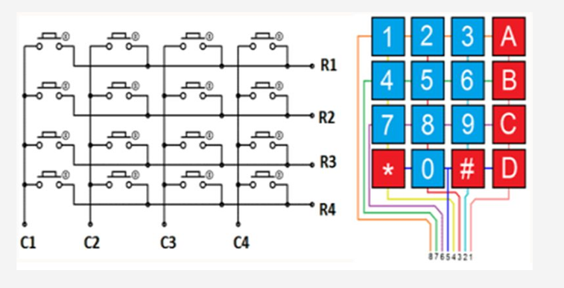
Solution :
To save some GPIO pins of microcontroller we can use Matrix keypad .
What is Matrix Keypad ?
Nothing is different from normal push buttons; the only difference is in the way the switches are connected.
@ 2026 Mohamed Magdy

Slide 12

Matrix Connection
Solution :
To save some GPIO pins of microcontroller we can use Matrix keypad .
What is Matrix Keypad ?
Nothing is different from normal push buttons; the only difference is in the way the switches are connected.
How many GPIO pins required to interface with 16 keys ?!
@ 2026 Mohamed Magdy

Slide 13
Matrix Connection
Conclusion :
Keypad is most widely used input device to provide input from the outside world to the microcontroller The Keypad makes and application more users interactive.
@ 2026 Mohamed Magdy

Slide 14

Matrix Connection
Matrix Connection Method
Multiplexed matrix keypad in this technique keys are connected in a matrix
Row/Column sytle
0
1
2
3
0
1
2
3
@ 2026 Mohamed Magdy

Slide 15


Understand Hardware
How to make this connection ?
@ 2026 Mohamed Magdy

Slide 16
Understand Hardware
How to make this connection ?
COL 0
COL 1
COL 2
COL 3
Row 0
Row 1
Row 2
Row 3
@ 2026 Mohamed Magdy

Slide 17
COL 0
COL 1
COL 2
COL 3
interfacing with Keypad
Row 0
Row 1
A Keypress establishes a connection between the corresponding row and column between which the switch is placed otherwise ; there is no connection between rows and columns
Row 2
Row 3
In order to read the Keypress, we need to configure the rows as outputs and columns as inputs
@ 2026 Mohamed Magdy

Slide 18


COL 0
COL 1
COL 2
COL 3
interfacing with Keypad
Row 0
Row 1
Columns are read after applying signals to the rows in order to determine whether or not a key is pressed and if pressed ,which key is pressed
Row 2
Row 3
rows and col inputs ?
floating as we need at least a signal to determine if key is pressed or not so we make one of them output and other is input
1 send and other receive ( Ping → Pong )
rows output ?
as output rows send signals high or low so we cam make one of them low and other is high or vice versa according to the connection ( pull up ) and this is called scanning
questions ?
Col input ?
To see if there is any signals reach the button ( Pull up ) ( High) if key pressed it goes down act as a sensor
rows and col outputs ?
Short Circuit maybe cause damage to the MCU means all are ( HIGH )
@ 2026 Mohamed Magdy

Slide 19
COL 0
COL 1
COL 2
COL 3
Scanning
Row 0
Row 1
if the button is pressed we need to get the location of the button , means the corresponding ROW AND COLUMNS NUMBER .
Row 2
Scan process starts by setting all the rows and columns as input pins .
Row 3
columns pins are connected to external pull up resistors to pull these pins to logic high values .
to scan switches in a row, MC configures it as output and sets it to low , then checks one at a time .
If a column line goes low , MC detects a pressed switch , it will be the switch connected between this row and column pins otherwise , no pressed switch , no pressed switch and goes to scan next row and so on .
@ 2026 Mohamed Magdy

Slide 20
Coding time
@ 2026 Mohamed Magdy
@ 2026 Mohamed Magdy

Slide 21
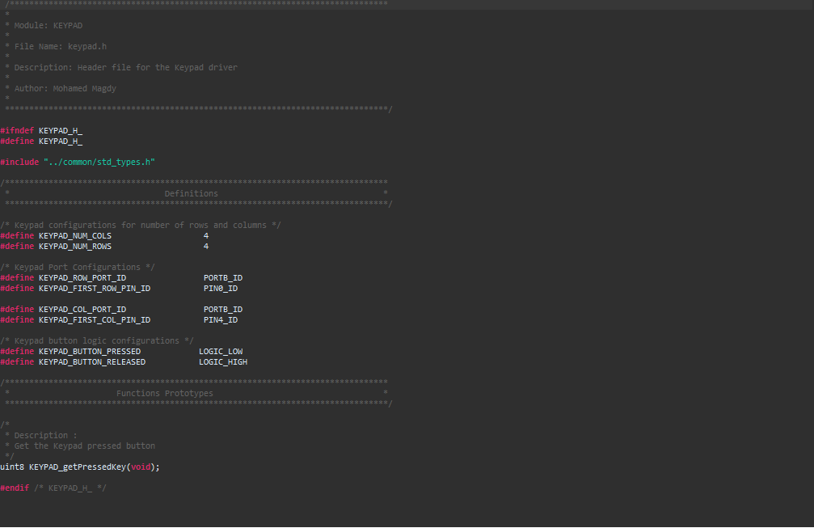
File.h
@ 2026 Mohamed Magdy

Slide 22
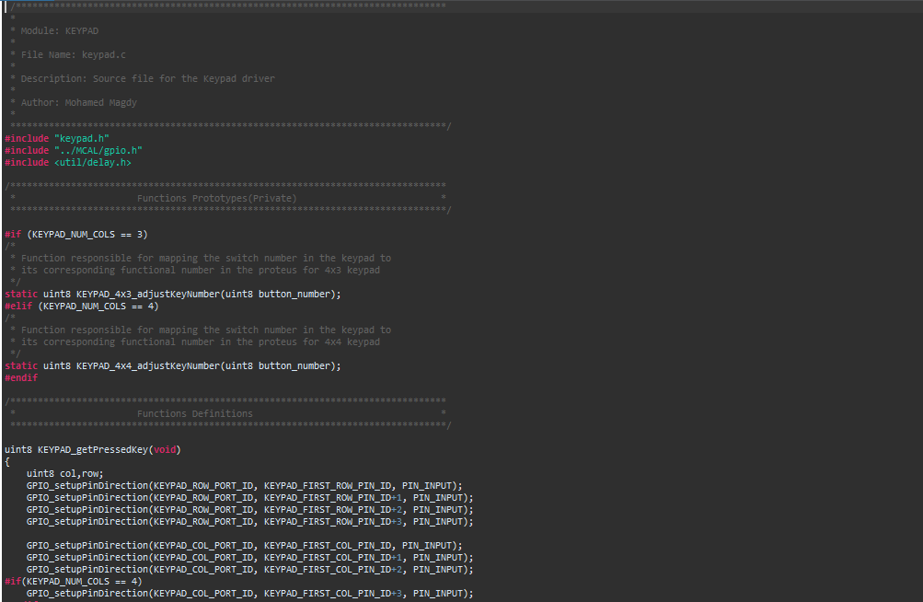
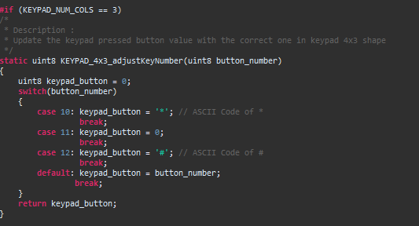
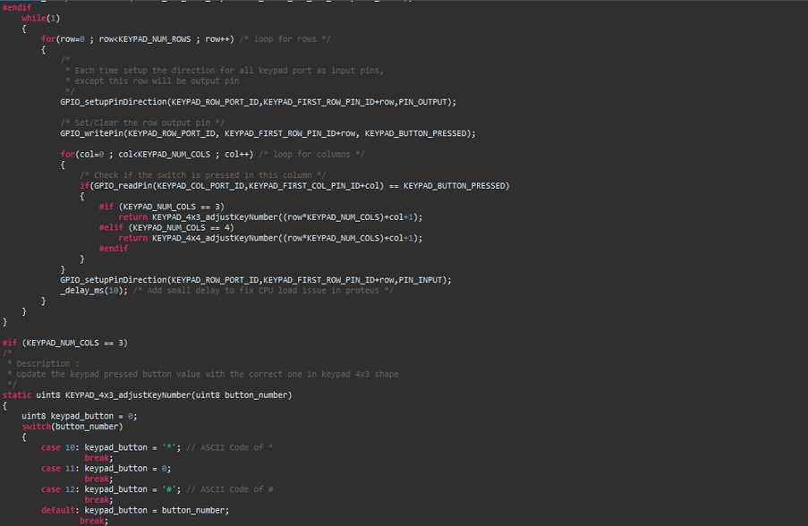
File.c
4*3
@ 2026 Mohamed Magdy

Slide 23
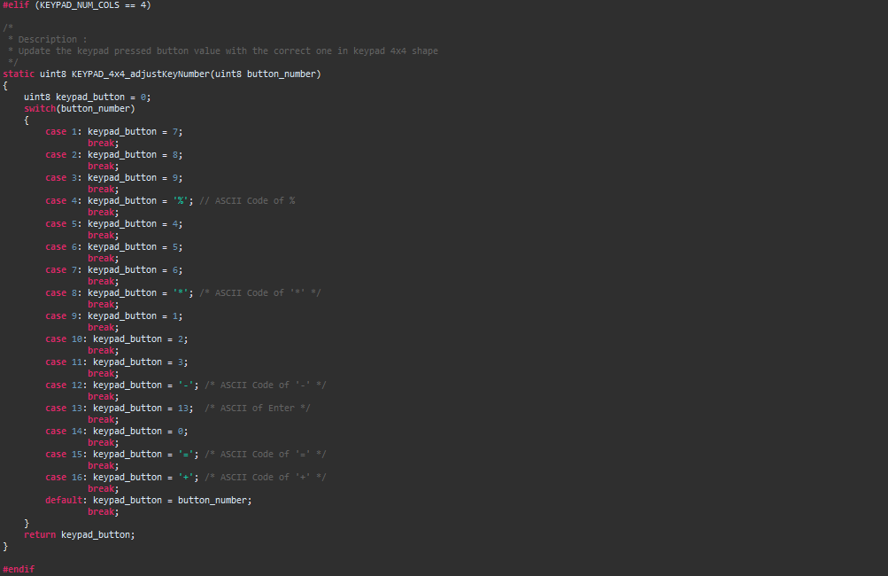
File.c
4*4
@ 2026 Mohamed Magdy

Slide 24

Questions
@ 2026 Mohamed Magdy
@ 2026 Mohamed Magdy

Slide 25

Break
@ 2026 Mohamed Magdy
@ 2026 Mohamed Magdy

Slide 26




Slide 27
Hello!
Instructor: Basma khaled
Cairo University, EECE Department.
Contact me:basmak55@gmail.com
LinkedIn:

Slide 28


Content
Why LCD
Understand how AVR talks to LCD
Know LCD pins and modes (4-bit vs 8-bit)
Be able to write a simple code to display text
Understand basic commands

Slide 29


Why Do We Need LCD in Embedded Systems?

Slide 30

Why Do We Need LCD in Embedded Systems?
Display sensor readings
Show system status
User interaction
Debugging tool

Slide 31
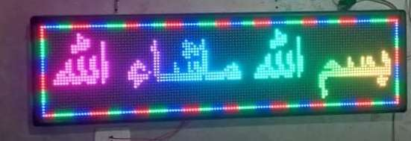
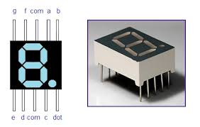
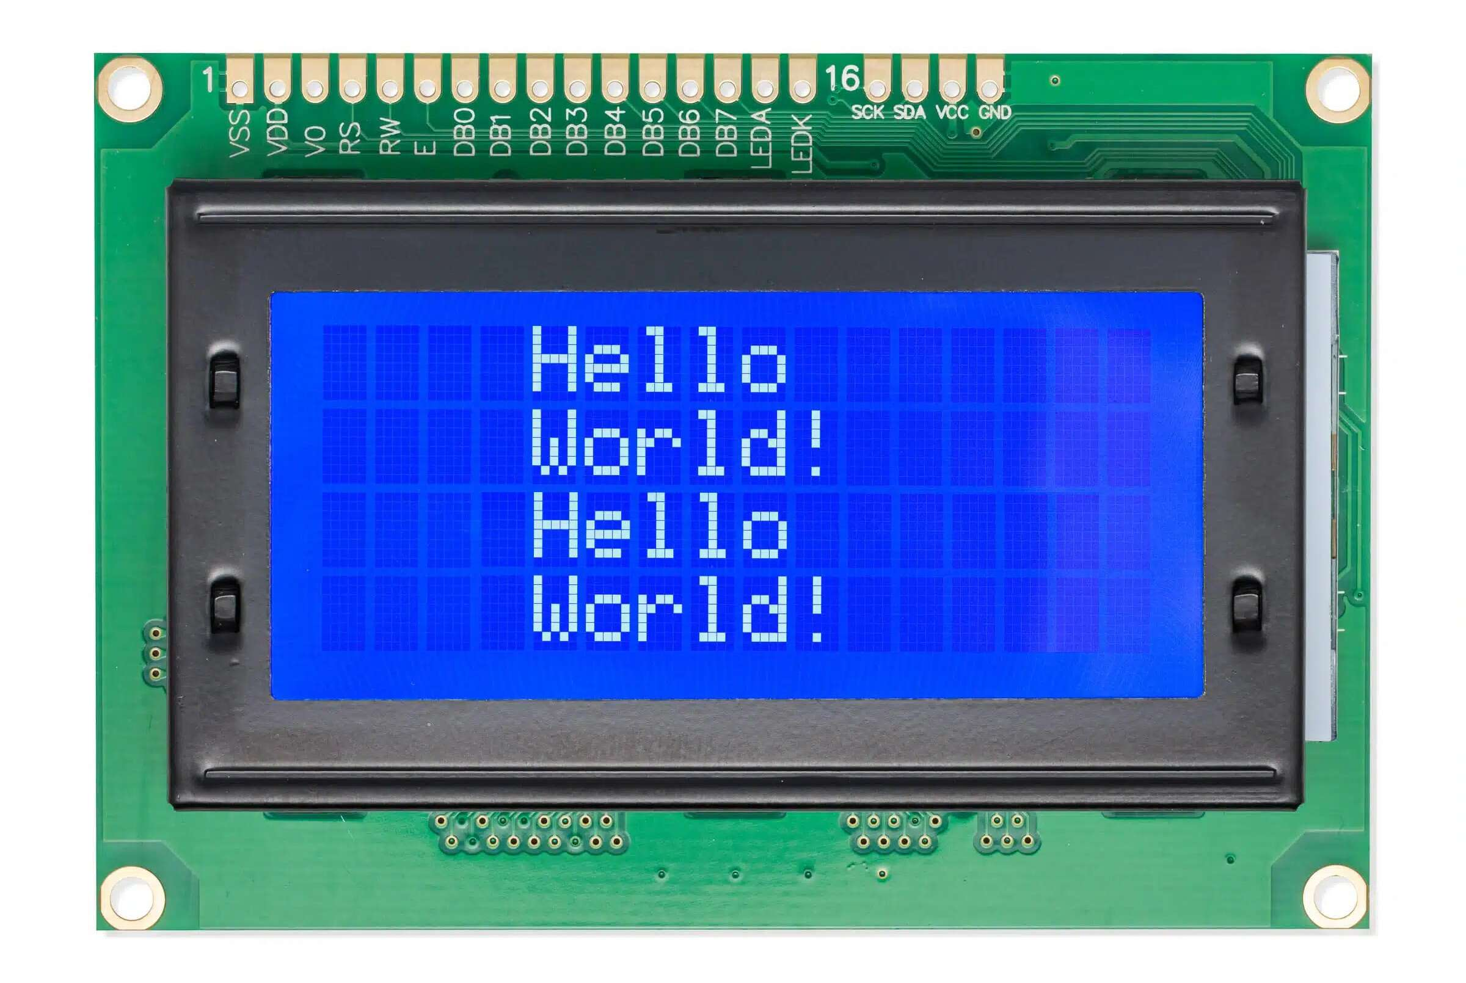
Types of display
Dot matrix Display
Segments Display
Character Display

Slide 32
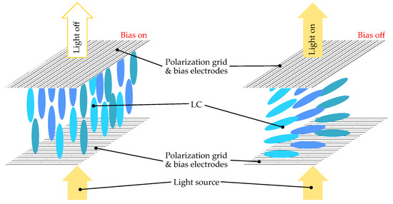
Liquid crystal mechanism

Slide 33
16x2 LCD Pin Configuration

Slide 34
16x2 LCD Pin Configuration

Slide 35
Character in LCD
CGROM: Character Generator ROM
Non volatile
Stores predefined characters
ASCII characters
DDRAM: Display Data RAM
Volatile
stores the display data represented in 8-bit character code.
Each address corresponds to one character position
CGRAM: Character Generator RAM
Non volatile
Used to create custom characters

Slide 36
Driver of lcd

Slide 37
Driver of lcd
Init
Send data
Send command

Slide 38
4-bit vs 8-bit Mode
Feature | 8 bit mode | 4 bit mode
Data lines | 8 | 4
Speed | Faster | Slower
Pins used | more | Less

Slide 39
Coding time
@ 2026 Mohamed Magdy
@ 2026 Mohamed Magdy

Slide 40
Assignment 5

Slide 41
Task 5
Extend your previous Traffic Light Project by integrating:
LCD display
Interface a 16x2 LCD with the microcontroller.
Display traffic light states on the LCD:
“RED ON”
“YELLOW ON”
“GREEN ON”
The LCD must update automatically when the traffic state changes.
Use your LCD driver (4-bit mode).
Keypad-based password system
Interface a keypad.
Create a password system with a predefined password (example: 1234)
User enters password using keypad
Display entered digits on LCD:
Show * instead of actual digits (bonus)
If password is:
Correct → Display “Welcome”
Incorrect → Display “Wrong Password”

Slide 42
Thank You!
Any questions?

